Slide 1
DHUM25A43 - 2
Investigating with AI
The Web
Feb 4th, 2025

Slide 2
What we saw last time
Course
Projects
State of AI
Tools: Colab
Demo: data analysis using Colab and Gemini

Slide 3
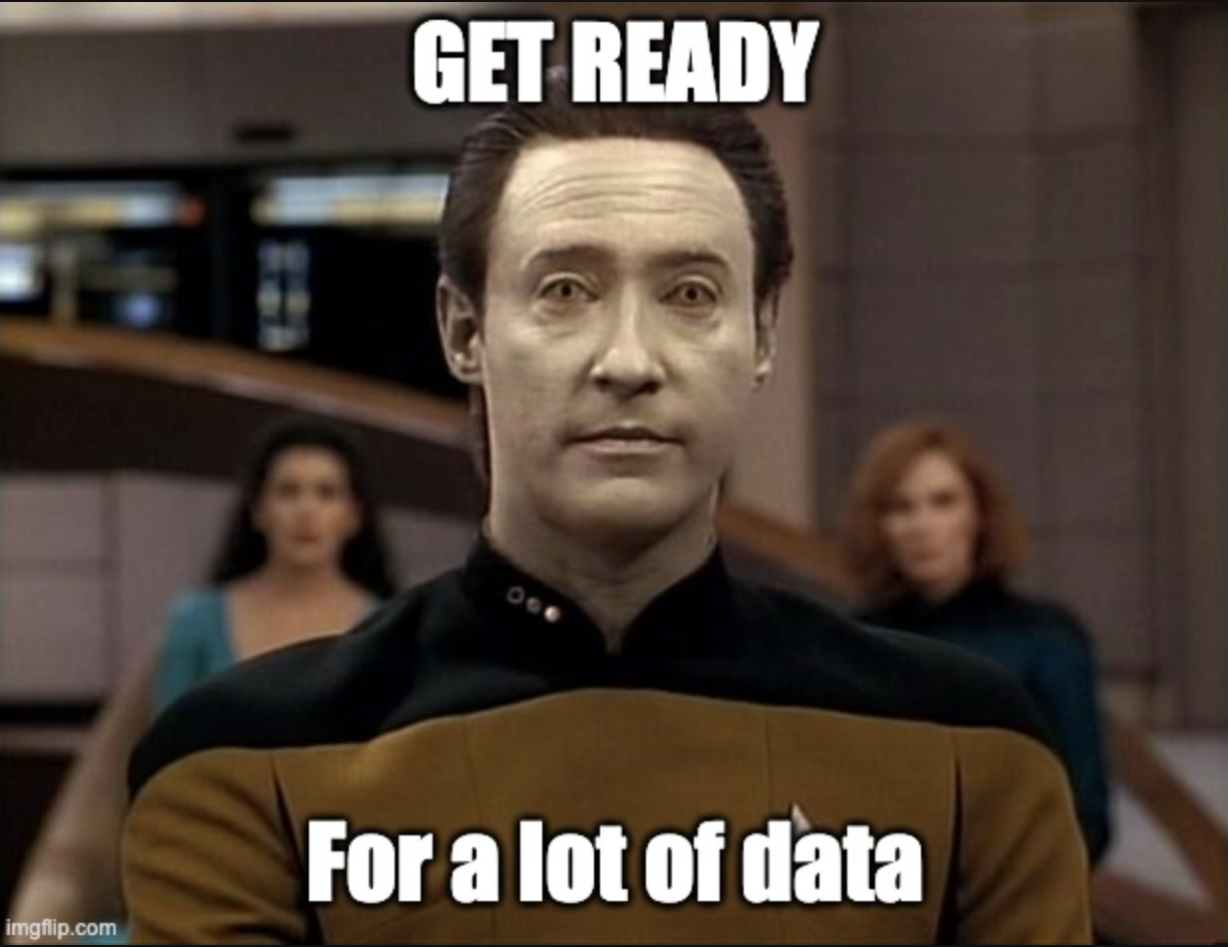
Today
Guided practice: analysis IMDB in Colab
Data sources
APIs and the web
Hands on: wikipedia API to build a dataset
Project reviews (45mn)

Slide 4
At the end of this class
You
understand what an API is
know the 4 operations in the REST protocol
can edit a JSON file
can query a simple API (wikipedia, )
understand best practice in terms of cap and throttling

Slide 5
Demo

Slide 6

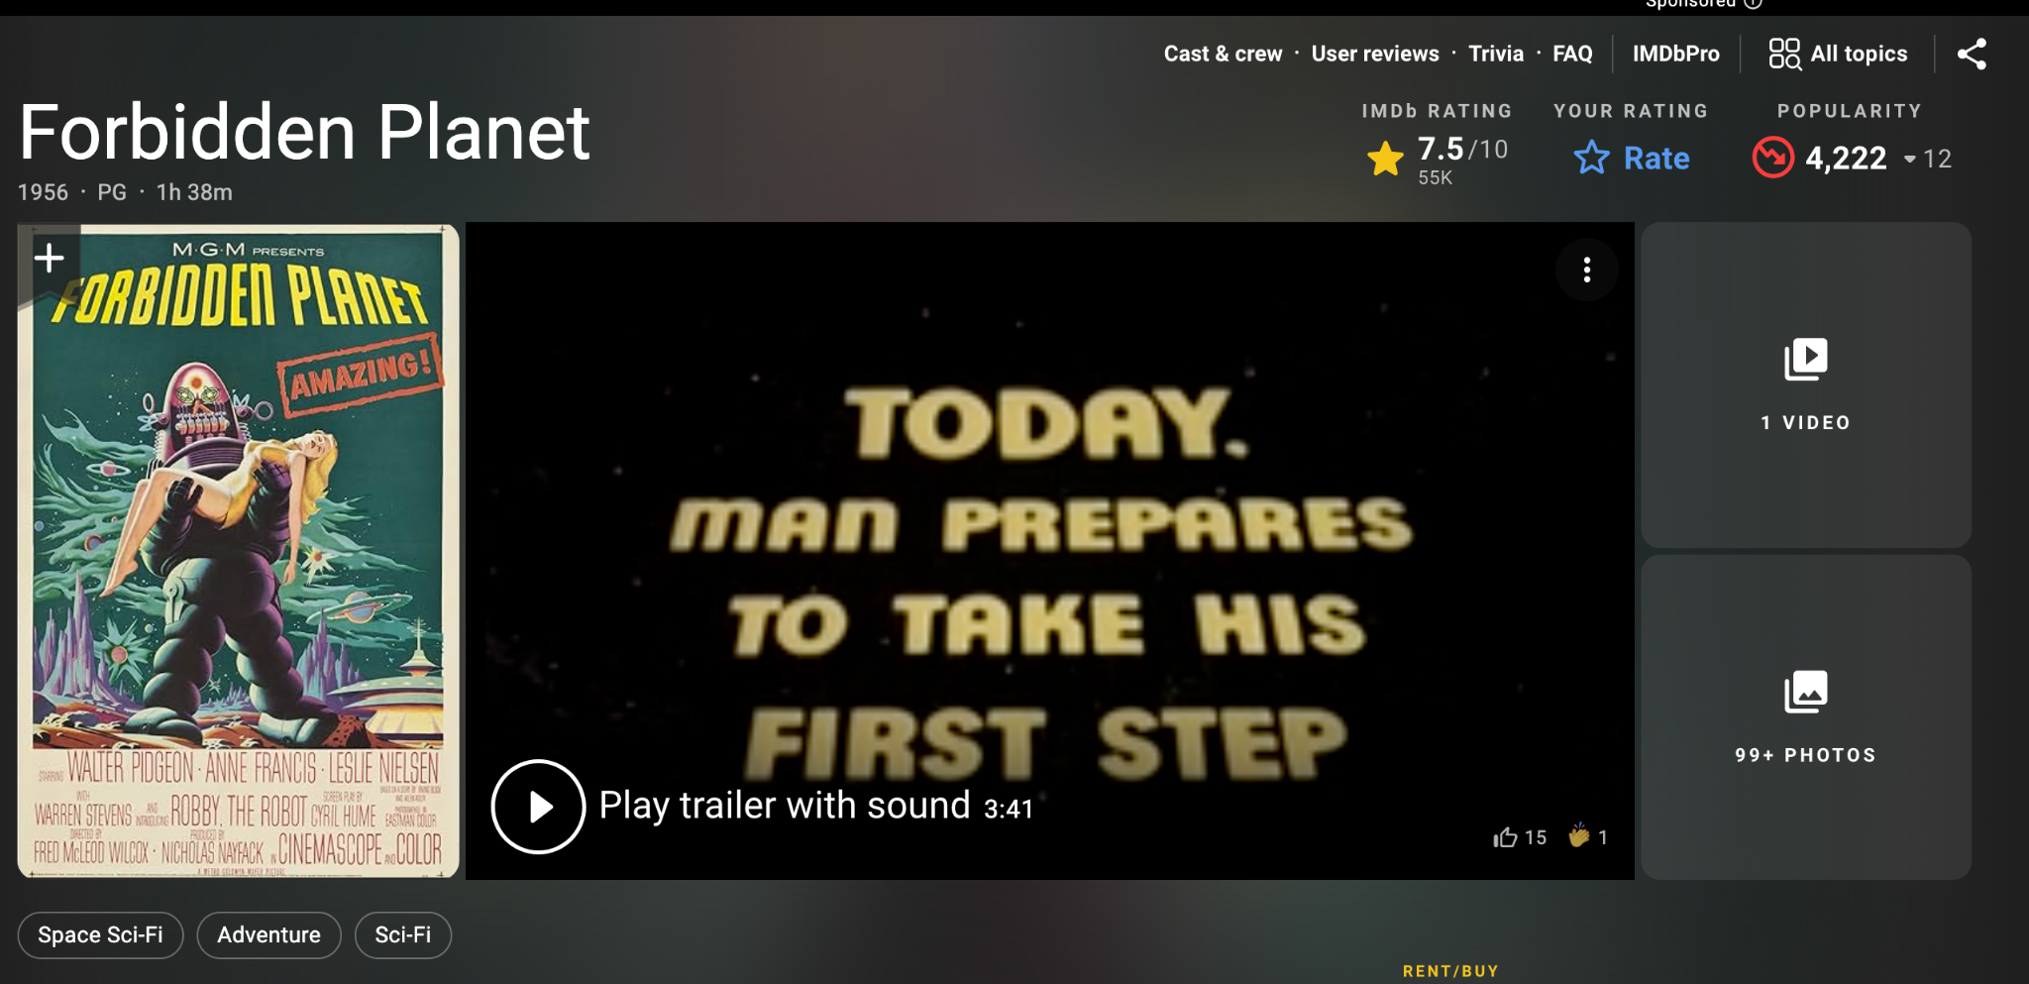
Let's analyze IMDB
The dataset is available in the shared data folder in google drive (csv file, google spreadsheet)
Download it to your laptop

Slide 7
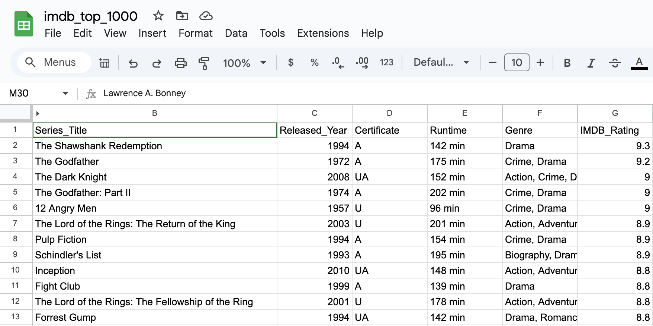
Movie Analysis
It contains information on 1000 movies
title
description
ranking (imdb, Meta)
duration
genres
actors, director
revenue

Slide 8
Notebook and follow along
This is the final Colab notebook: demo_imdb_02
The prompts are available here
We'll start with a new colab notebook
First: upload the csv data file to the notebook

Slide 9
Demo
create a new notebook
upload the csv file to the notebook
ask Gemini to
load the data
analyze the data
suggest & explain
extract information from the movie description
save the new data
share the notebook

Slide 10
Open source ?

Slide 11


Open source vs closed source
A distinction relevant for all software including AI models
Open source:
The code is public.
Linux, OpenOffice, Firefox, Chromium, Python, major databases,
Can be copied and modified by anyone
Closed source:
The code is proprietary.
Windows, Word, Chrome, Edge, Oracle
needs a license to use, black box

Slide 12
Open source is good for:
Since the code is public:
Innovation & Flexibility: Users modify and enhance the software independently. Community-driven development, faster bug fixes, customization of code
Security & Transparency: Security verify there's no virus. Issues are identified and patched quickly by the community.
Cost-Effective: for users: free to use and modify, reduced licensing costs; no vendor lock-in. and for creators: community driven intelligence.
And
Knowledge Sharing: Developers learn from existing code, accelerating skill development and innovation, shared knowledge and best practices.
Long-term Viability: the community keeps on improving the software long after the initial devs have left the project

Slide 13




Open source LLMs
Different levels of openness:
model : you can download the model and use it as is
code: the code to create the model
training data: the data used in training the model
Some models are fully open (DeepSeek), partially open (LLama, Mistral 7B), or closed (OpenAI o1, Claude Sonnet, Gemini)

Slide 14
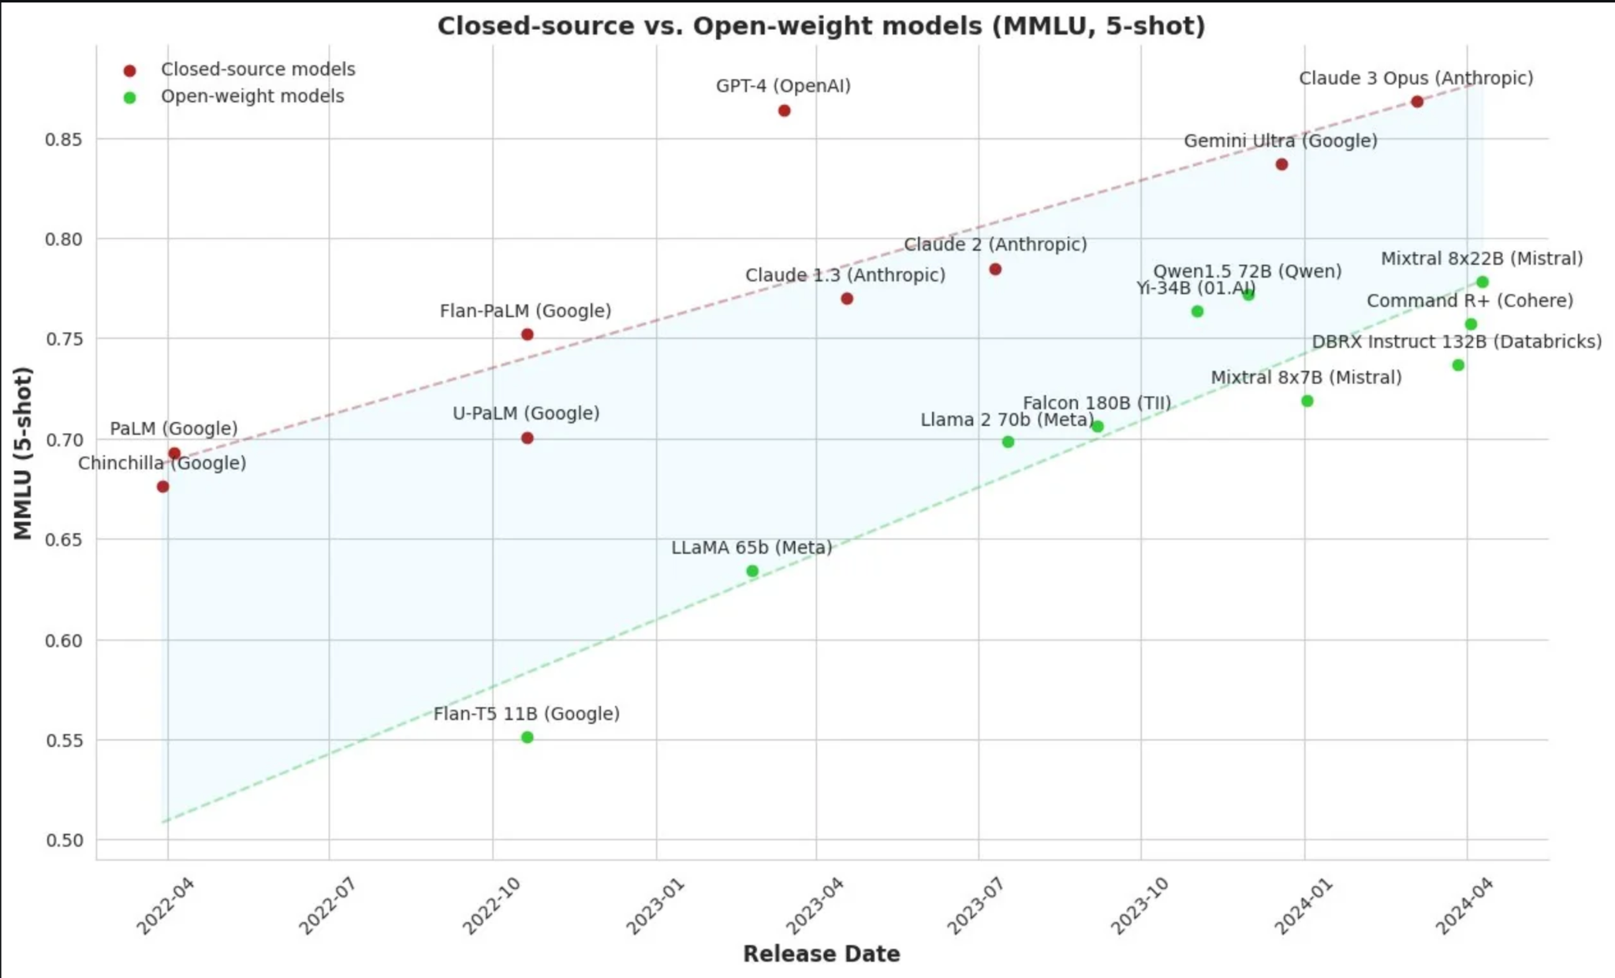
Open source - Performance
deepseek-R1

Slide 15
Datasets & datasources

Slide 16
Datasets & datasources
News and Media
Examples: Newspaper archives (NYT, Factiva, Europress etc.), Youtube (captions, comments, metadata), websites
Scholarly and Scientific Articles
Examples: Academic journals, repositories like PubMed, arXiv, JSTOR.
Encyclopedic and Knowledge Bases
Examples: Wikipedia / Wikidata, Encyclopedia Of Science Fiction
Entertainment and Cultural Datasets
Examples: IMDb for film and television data, GoodReads
Government and Legislative Data
Examples: Parliamentary records, government publications, election results
Consumer Reviews
Examples: Amazon Reviews, CellarTracker

Slide 17

Kaggle datasets
Obtain and analyze an existing CSV dataset for the project.
Find Open Datasets and Machine Learning Projects | Kaggle
NYT Articles: 2.1M+ (2000-Present) Daily Updated
NYT Articles: 2.1M+ (2000-Present) Daily Updated
NYT Articles: Small Processed 500k Version
IMDB dataset
IMDb Dataset
IMDB Dataset of 50K Movie Reviews
IMDB Dataset of 50K Movie Reviews
arXiv Dataset
arXiv Dataset
…

Slide 18

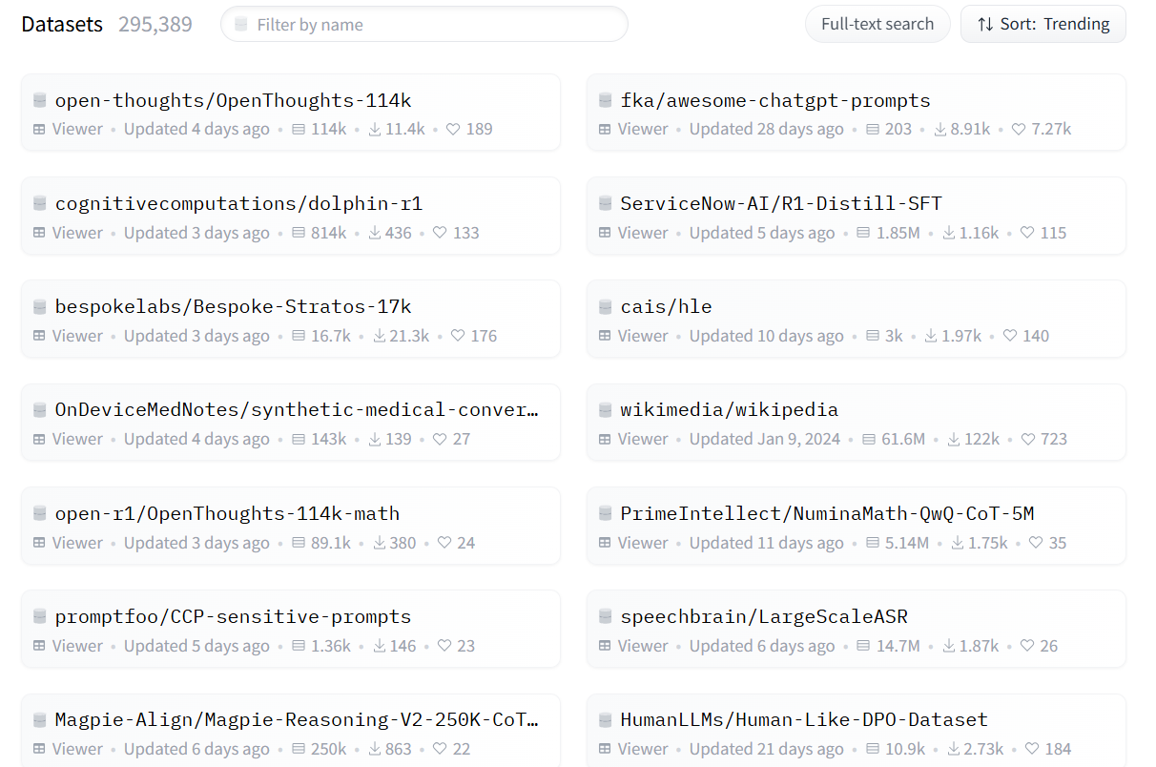
Hugging Face – The AI community building the future.

Slide 19
Literature
GoodReads 100k books
GoodReads Best Books
GoodReads 100k books
Encyclopedia Of Science Fiction
Encyclopedia Of Science Fiction : Free Download, Borrow, and Streaming : Internet Archive
Awesome Sci-Fi
GitHub - sindresorhus/awesome-scifi: Sci-Fi worth consuming
Awesome-fantasy
GitHub - RichardLitt/awesome-fantasy: :european_castle: Fantasy literature worth reading

Slide 20
Scraping
Minet: GitHub - medialab/minet: A webmining CLI tool & library for python.
Crawl (using a declarative language to define a browsing behavior, and what to harvest)
Mine or search:
Mediacloud (requires free API access)
Twitter (requires free API access)
Wikipedia
Youtube (requires free API access)
Scrape (without requiring special access, often just a user account):
Facebook
Instagram
Telegram
TikTok
Twitter
Google Drive (spreadsheets etc.)

Slide 21
Scrape NYT
https://colab.research.google.com/drive/14HDOUMmkoijYktlZ9RtUcA8uuW7Q0gPP?usp=sharing

Slide 22
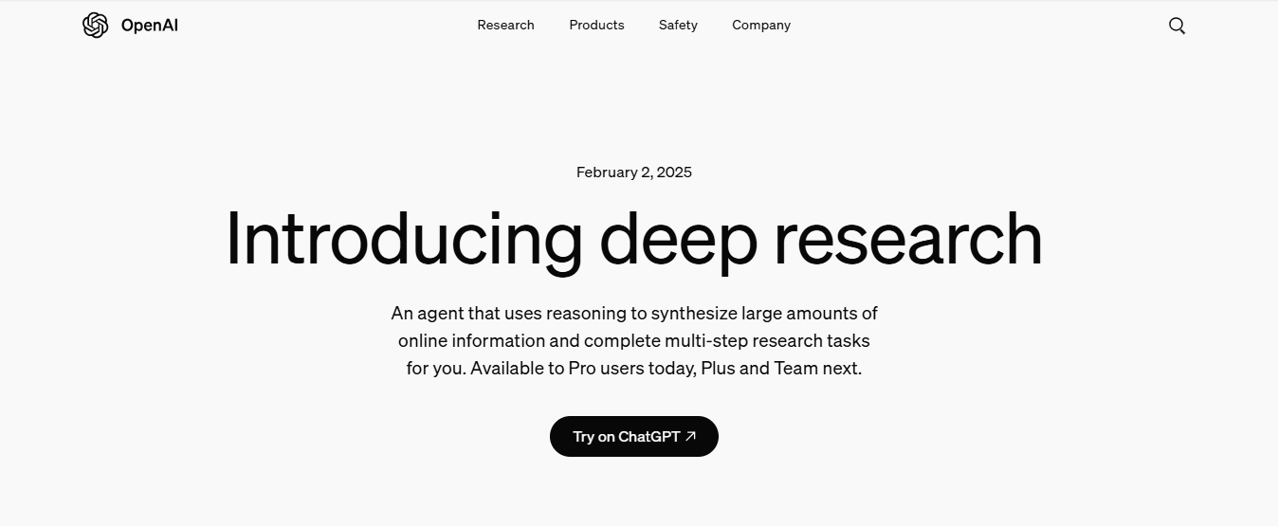

Slide 23
API
Application Programming Interface

Slide 24
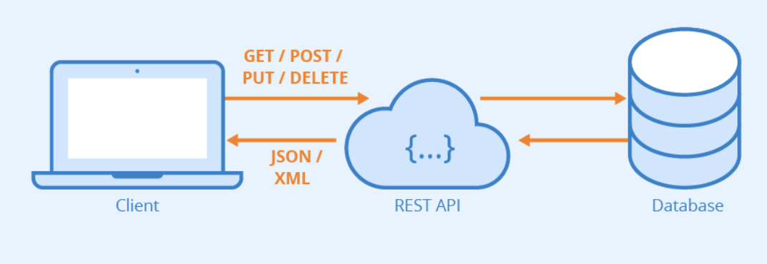


API
A generic definition
An API is a connection between computers or between computer programs.
It is a type of software interface, offering a service to other pieces of software.
(In contrast to a user interface, which connects a computer to a person)
A more practical definition
An API defines the methods and data formats that applications can use
to request and exchange information.

Slide 25
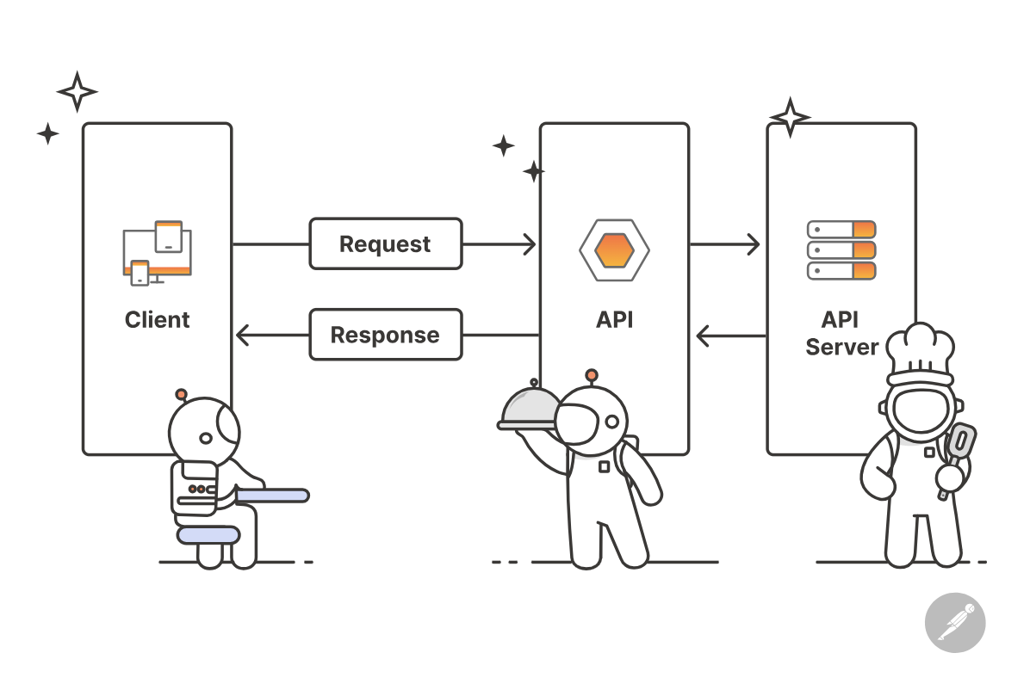
API
You send a request to a web address : a url
The server answers the request
You get back some data

Slide 26
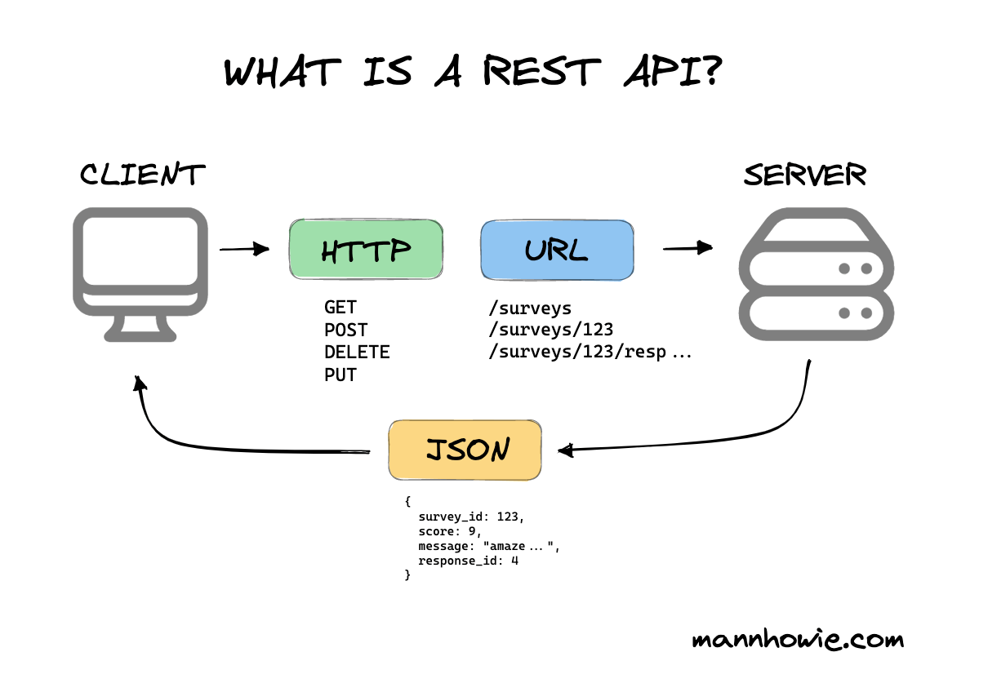
Web = One BIG API + GET requests
on your browser you go to a url. This is the initial GET request
that request triggers a call to the server.
the server sends you back the html page as the response

Slide 27
The Web is an API
Let's illustrate

Slide 28
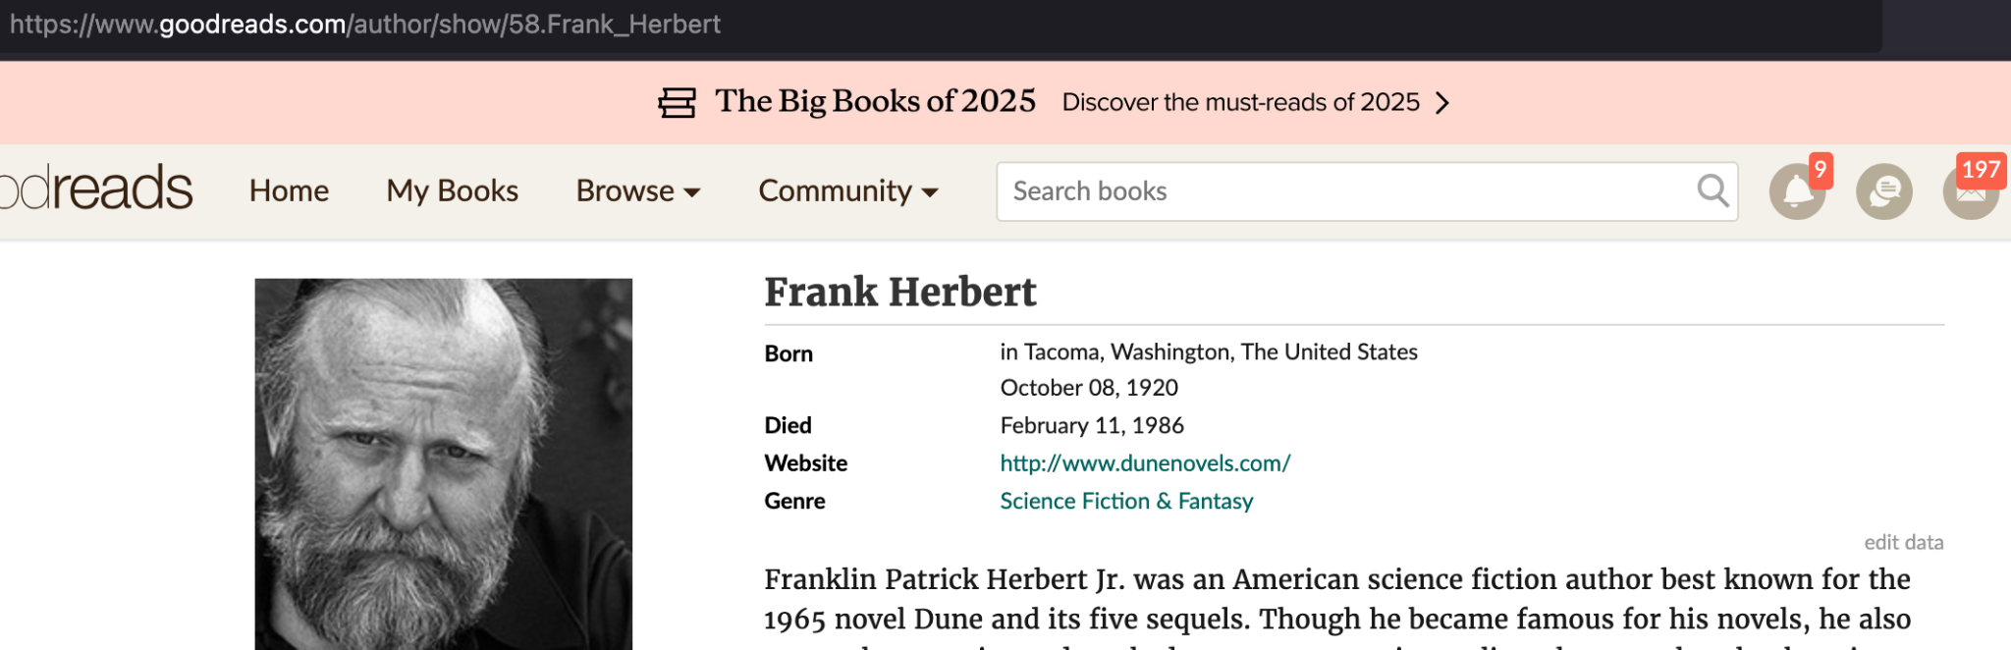
The web is one gigantic API
It uses URLs to send requests to a server
The server sends the html page back
Go on https://goodreads.com
Search for Dune
Click on the author's name Frank Herbert
You should end up on this URL:
https://www.goodreads.com/author/show/58.Frank_Herbert

Slide 29
What's a URL ?
A URL (Uniform Resource Locator) is the address of a unique resource on the internet.
https://www.goodreads.com/author/show/58.Frank_Herbert
domain
name
The data you request
show an author,
with label 58.frank.herbert

Slide 30
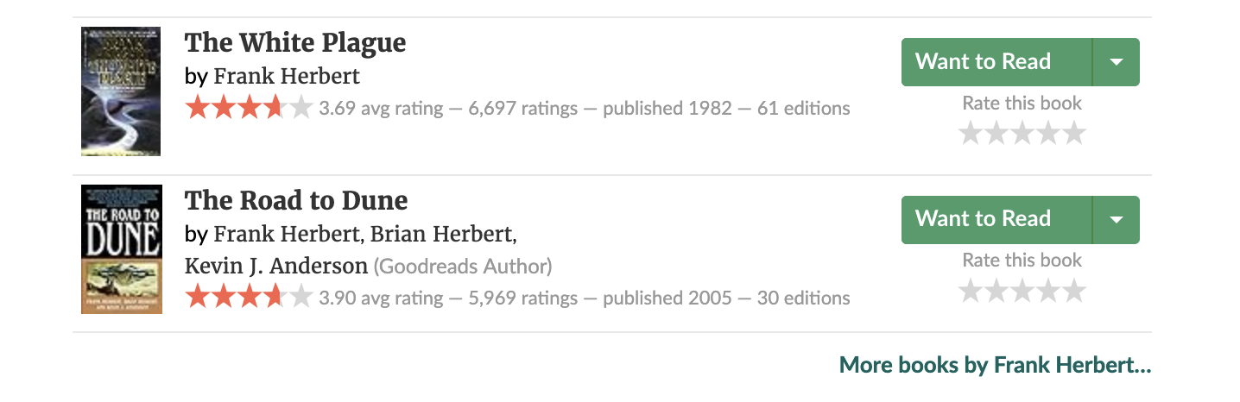
/list instead of /show
Now scroll down and click on "More Books by Frank Herbert"

Slide 31
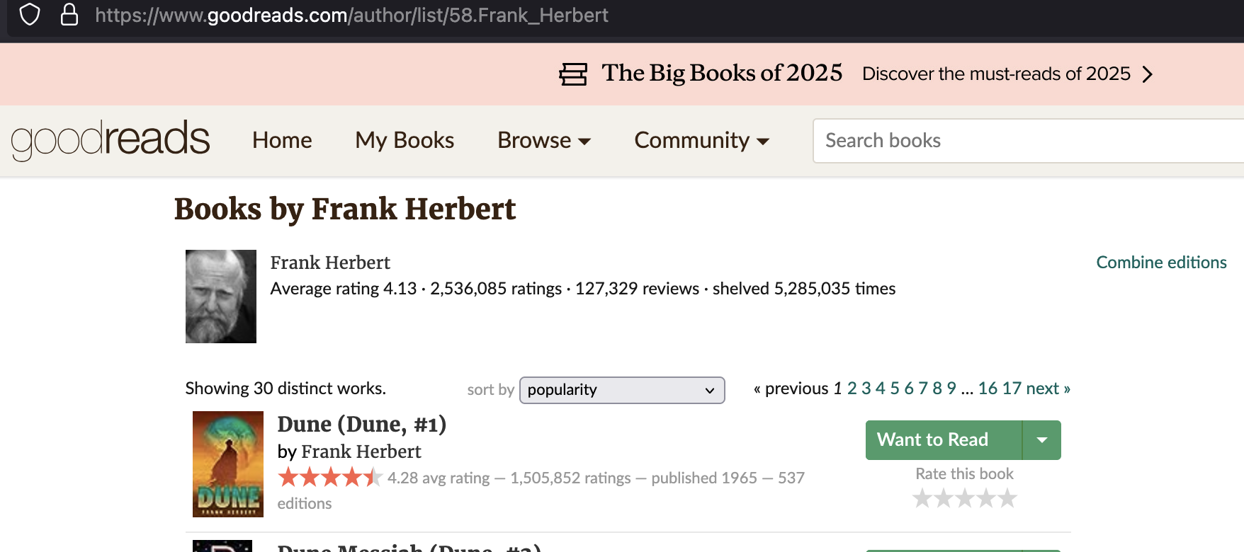
/list instead of /show
The URL is now https://www.goodreads.com/author/list/58.Frank_Herbert
The verb "/show" is replaced with the verb "/list".

Slide 32
Parameters: ?page=2&per_page=30
Now click on page 2
The URL becomes https://www.goodreads.com/author/list/58.Frank_Herbert?page=2&per_page=30
which reads
list all the works of author 58.Frank_Herbert
show page 2
and show only 30 works per page

Slide 33
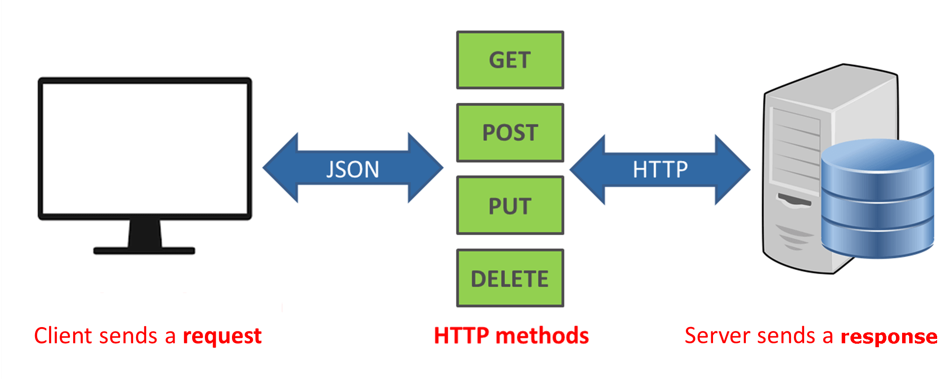
REST is the building block of the internet
An endpoint: a URL + a verb + parameters
A method : here the method is to GET the page
The html page as the server response
By extending this concept of method, we define the 4 verbs of a REST API
read: GET
create: POST
update: PUT
delete: DELETE

Slide 34
Beyond html: JSON
There are multiple API standards and languages
And APIs can return all sorts of content: html, text, xml, pdfs,
APIs often return raw data formatted as JSON
JSON (JavaScript Object Notation) is a lightweight data format.
easy for humans to read and write.
easy for machines to parse and generate.

Slide 35
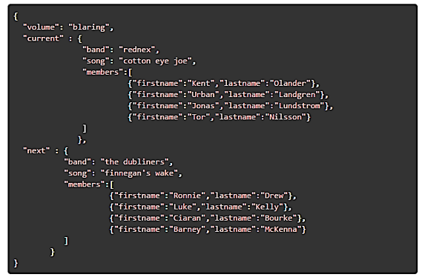
Here's
an
example

Slide 36
How do you edit a JSON file ?
do not use word of google docs. these are for real text
use a code editor such as vscode (but it's overkill for just editing JSON)
An online JSON formatter and editor is a good alternative
https://jsoneditoronline.org/
and many others

Slide 37
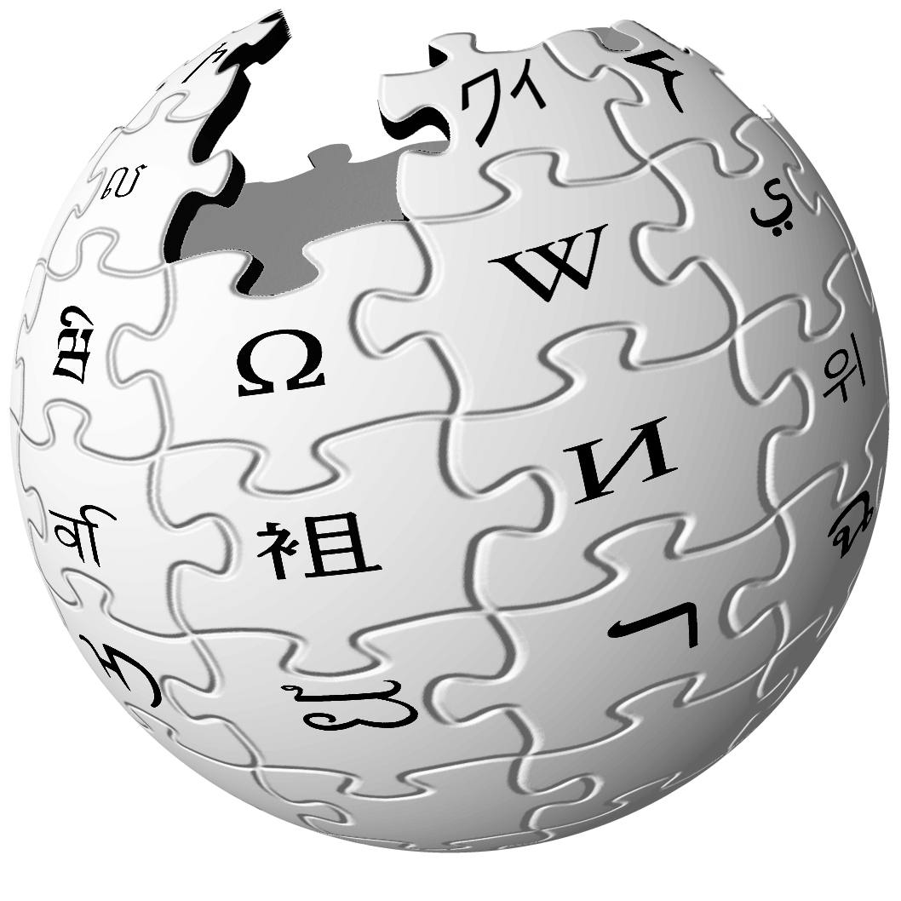
Wikipedia API

Slide 38
The wikipedia API
Check out :
The API documentation https://www.mediawiki.org/wiki/API:Main_page
The wikipedia python library: https://wikipedia.readthedocs.io/en/latest/code.html
AI studio: https://aistudio.google.com or chatGPT as an alternative to generate code
The sandbox : https://en.wikipedia.org/wiki/Special:ApiSandbox

Slide 39
Your turn
Constitute a dataset of content from wikipedia pages related to a given topic.
Think of
page attributes
generate list of pages beforehand
tell the LLM to use the wikipedia library
how you output the data
For instance :
Extract all information related to immigration from European capitals pages
Given a list of political parties en France, find their position on the environment

Slide 40
Steps
The method is important. It's a gradual iterative process. build on a series of small actions
Using the wikipedia api library, find the page for Paris
In the page of Paris, extract the section titles
In the section titled Demographics or equivalent, extract the information on immigration

Slide 41
Prompts Precisions
The LLM has a tendency to recreate the whole code from scratch (installing etc …). To avoid that, state that the libraries are already installed, the page is already available etc
The code is often too complex. I specify : simple code, not for production, no error handling, python beginner level
Ask for potential methods first (and no code), then specify the one you want to generate the code.

Slide 42
Projects

Slide 43
Seed projects
Climate change, energy
Turan Kerem: “ two potential research questions focusing on climate change and diplomatic negotiations at COP meetings”
1 debate over legal and financial responsibility…
2 financial solution mechanisms for climate change…
Andrei: Innovations in Geoengineering (Stratospheric Aerosol Injection, Marine Cloud Brightening)
Controversies Surrounding Geoengineering, Technological Uncertainties, Risks…
Data: Press, scientific publications, news…
Interesting datasets:
10 Years of Climate Science Denial on RCGroups
Public Opinion on Climate Change (Updated Daily)
Earth Negotiation Bulletins for the COPs 1995-2016 - Harvard Dataverse
AI - robotics
Andrei: AI and the Future of Work
The Fear: "We'll Lose Our Jobs", Sectors at Risk, The Skills Gap, Emergence of AI-Related Roles
Data: Press, scientific publications, news…
Andrei: Artificial General Intelligence (AGI) and the technological singularity
Ability to predict or control it, Potential Benefits and Risks
Brain–computer interface
Andrei: Risks and Controversies, Neuroenhancement, Brain implants, Transhumanism, neurocybernetic augmentation
Data: press, web, scientific publications, sci-fi movies and literature
Other themes:
Carla: supermarket’s data to try to anticipate customers’ behavior

Slide 44
Projects
Let's review your projects

Slide 45
For next time

Slide 46
Build a web search dataset
ask an LLM for web search APIs
for each (google and bing search for instance)
how to get an API key
boilerplate code example
or use the Duckduckgo_search python library
boilerplate code example

Slide 47
Watch out
The code generated by Gemini had trouble with capitalization the right code for duckduckgo should be
from duckduckgo_search import DDGS
results = DDGS().text("Paris", max_results=5)
print(results)

